Slide 1
PHYSICS – I PH11001
Topics to be covered:
Classical systems and oscillations
Wave motion
Electromagnetic waves
Wave/quantum mechanics

Slide 2




Teachers This semester
Prof. Utpal Sarkar Section: 11-12
Prof. Arghya Taraphder Section: 13-14
Prof. Sudhansu Sekhar Mandal Section: 09-10
Dr. Debamalya Banerjee Section: 15-16

Slide 3
Reference Books
The Physics of vibration and waves, H. J. Pain,
John Wiley and Sons, Ltd.
Introduction to Electrodynamics, David. J Griffiths,
Phi learning Pvt. Ltd., (Indian edition)
Quantum Physics of Atoms, Molecules, Solids, Nuclei
and Particles, Robert Resnick and Robert Eisberg, Wiley India
Oscillations and Waves, Somnath Bharadwaj and
S. Pratik Khastgir (ebooks freely available)
Marks distribution
Mid Semester exam: 30
End Semester exam: 50
Tutorial and test: 20
Total: 100

Slide 4
Time evolution of Classical System
Trajectories of Particles
For a single particle:
F = Force on the particle;
m = mass of the particle; x = displacement;
t = time; v = velocity; a = acceleration.

Slide 5
In absence of any external force,
F = 0
Momentum is conserved:
Initial momentum P_{i} = Final momentum P_{f}
In more general case, like two body collision ,
space displacement implies momentum conservation.
(will be discussed later)

Slide 6
Symmetries and Conservation Laws:
Symmetries | Conservation Laws
Time translation | Energy
Space displacement | Momentum
Rotation | Angular Momentum
Angular Momentum:

Slide 7
Energy
Energy of a system is its capacity to do work
Work
Work done by the force F for small displacement
Energy of an isolated system cannot be increased or decreased, but can change from one form to another
There are two forms of energy: Kinetic and Potential energy

Slide 8
Kinetic Energy
Kinetic energy of an object moving with a velocity v with respect to an observer:
Work done by an external force equals change in the kinetic energy of the system

Slide 9
Potential Energy
Total energy E is sum of kinetic energy T and potential energy V
Conservation of E implies change in T is compensated by change in V, so define V(x)
Absolute potential energy does not make sense, only change in potential energy can be measured

Slide 10
Example of potential energy calculation
1) Attractive inverse square force (gravitational attraction)
2) Spring force (Hook’s law)

Slide 11
Energy Conservation
Rate of change of energy:
We used: F=ma, where the force F is
the derivative of the potential V.

Slide 12
Many particle system
Consider a system of several particles:
Equations of motion for the system becomes:
This will become more complicated when there are
interactions between the particles and there are constraints

Slide 13
Lagrangian
We can arrive at the same equations of motion for the system, starting with a Lagrangian L:
that satisfies the Euler-Lagrange equation:

Slide 14
Constraints and Generalized coordinates
For many particle systems, the external forces may
be distinguished from the internal forces of constraints:
For N particles, there are 3N coordinates. If there are n constraints, then (3N-n) generalized coordinates can describe the system, that is, the system has 3N-n degrees of freedom.
The Lagrangian and the Euler-Lagrange equation then become

Slide 15
Classical Action and Hamilton’s Principle
The classical action of a system is defined as:
The Hamilton’s principle states that for the optimal classical trajectory
If the Lagrangian does not depend on any generalized coordinate q_{i} explicitly, the corresponding generalized momentum is conserved.
Example: Free particle

Slide 16
Hamiltonian
The generalized momentum, defined as
becomes the usual momentum in
absence of any constraints.
The Hamiltonian of any system is defined as
The Hamiltonian represents total energy of the system and
it satisfies the equations:

Slide 17
We shall next study a system with one of the
widely used potential: Simple Harmonic Oscillator
We can formulate the problem by defining the force
We can also start with the Lagrangian
Euler-Lagrange equation then gives

Slide 18
Similarly, the Hamiltonian for the system:
Show that this leads to the same equation of motion
Combining two, we can write

Slide 19
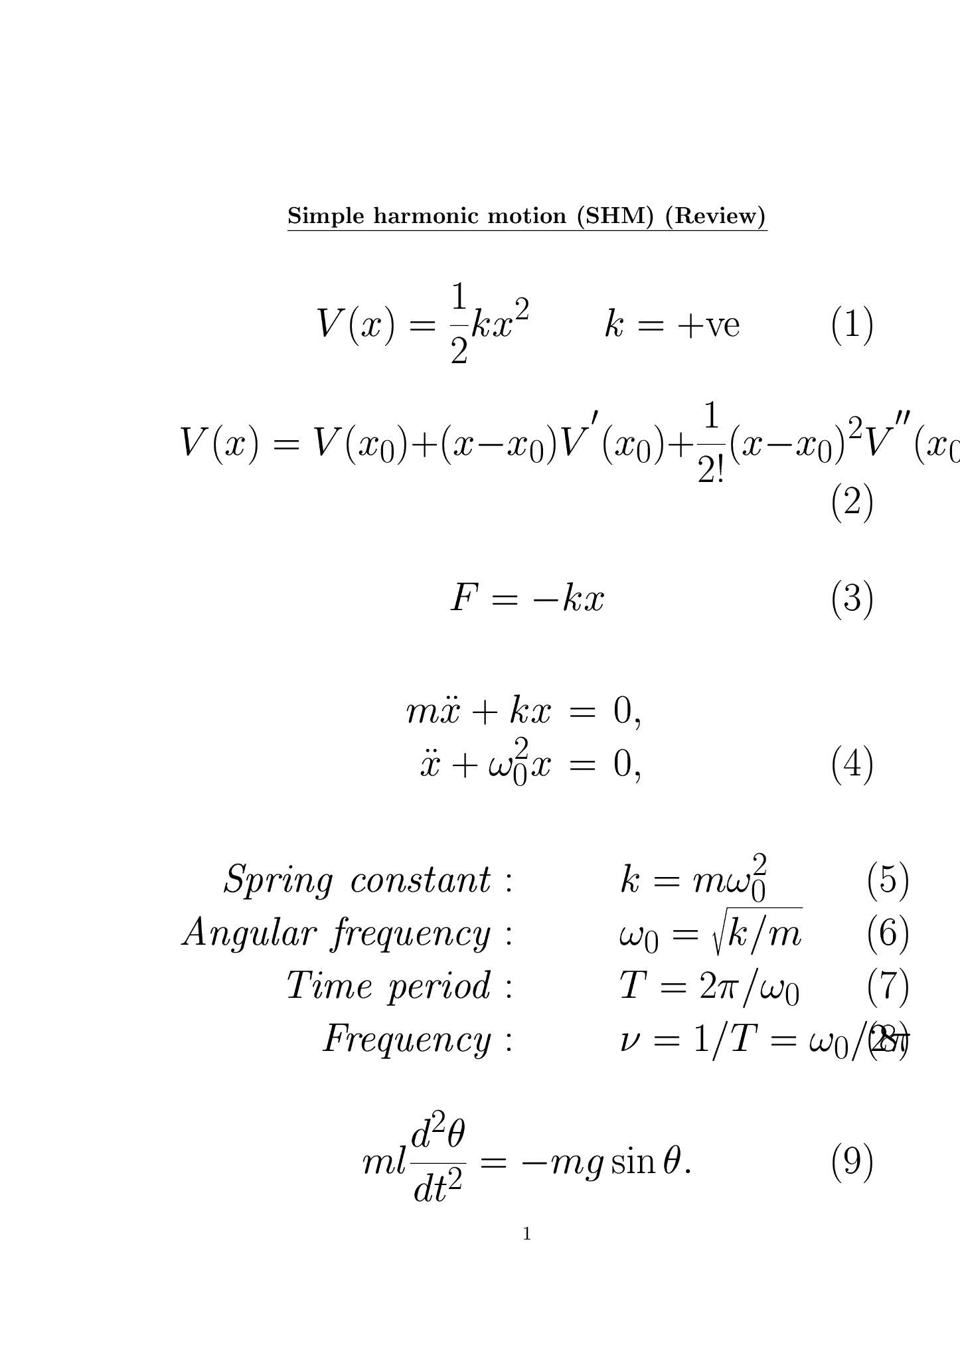
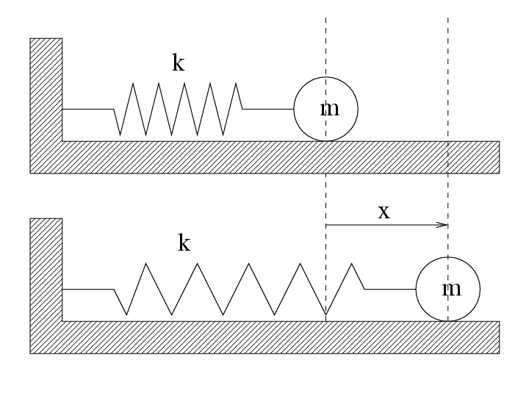
Simple Harmonic Oscillator SHO
PHYSICS 1

Slide 20
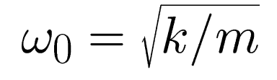
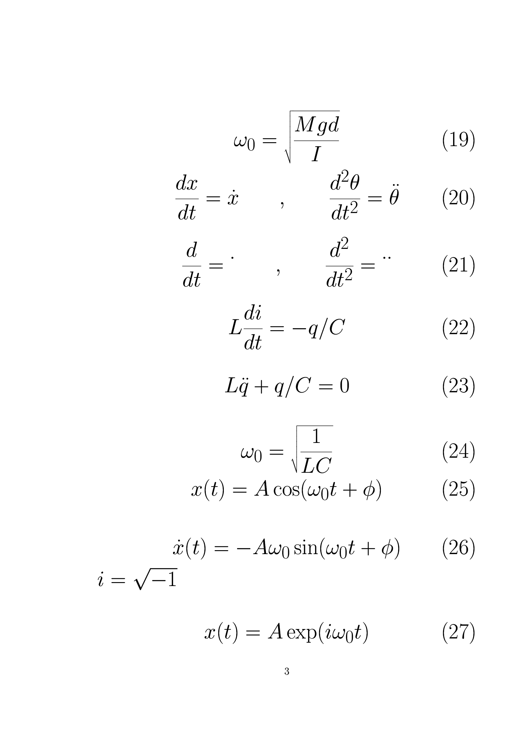
SHO Solution
PHYSICS 1
Somnath Bharadwaj and Pratik Khastgir, Department of Physics and Meteorology, IIT Kharagpur, 721 302 India
http://www.cts.iitkgp.ernet.in/~phy1/

Slide 21

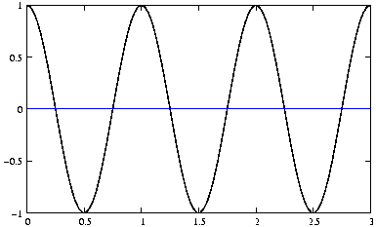
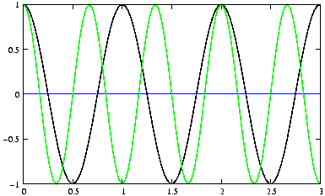
Angular Frequency
Time Period
PHYSICS 1
x
t
Somnath Bharadwaj and Pratik Khastgir, Department of Physics and Meteorology, IIT Kharagpur, 721 302 India
http://www.cts.iitkgp.ernet.in/~phy1/

Slide 22
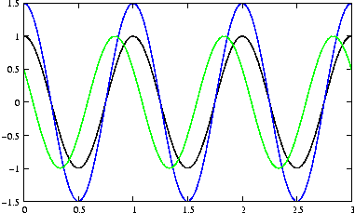
Amplitude A and Phase
PHYSICS 1
Somnath Bharadwaj and Pratik Khastgir, Department of Physics and Meteorology, IIT Kharagpur, 721 302 India
http://www.cts.iitkgp.ernet.in/~phy1/

Slide 23
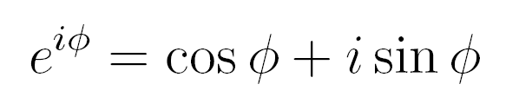
Complex Numbers
PHYSICS 1
Somnath Bharadwaj and Pratik Khastgir, Department of Physics and Meteorology, IIT Kharagpur, 721 302 India
http://www.cts.iitkgp.ernet.in/~phy1/

Slide 24


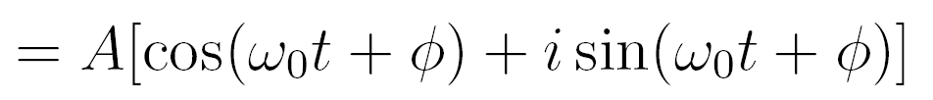
Complex Representation

Slide 25
The real part of the complex number.
represents the oscillating quantity

Slide 26
Complex Amplitude

Slide 27



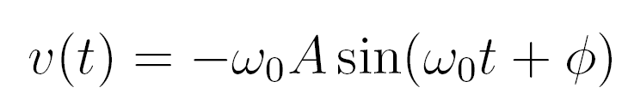
Complex Velocity
Velocity

Slide 28

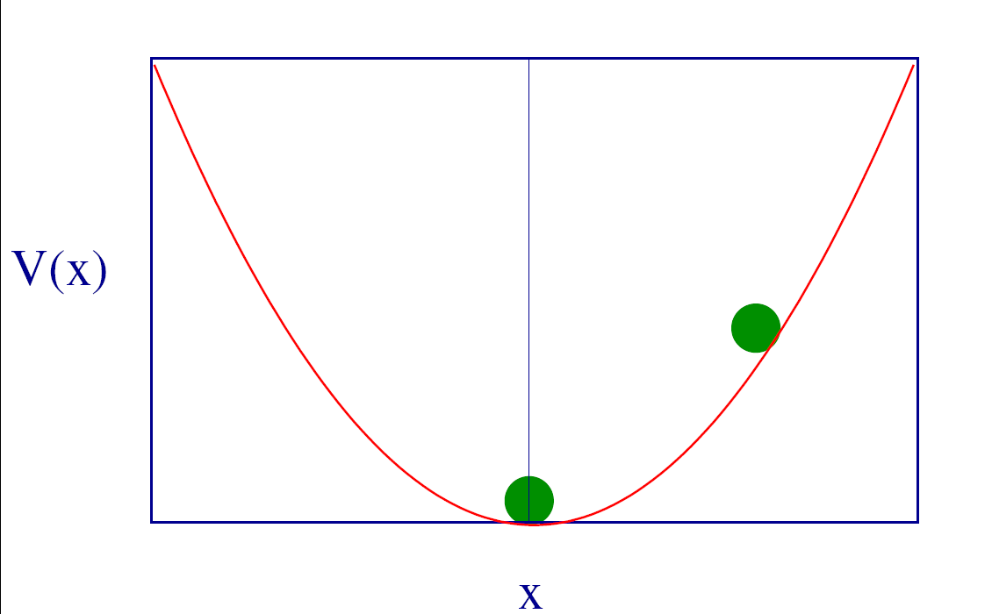
Potential V(x)

Slide 29
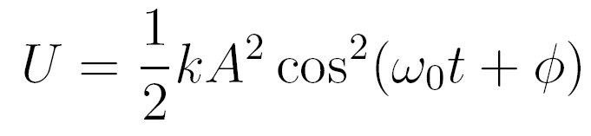
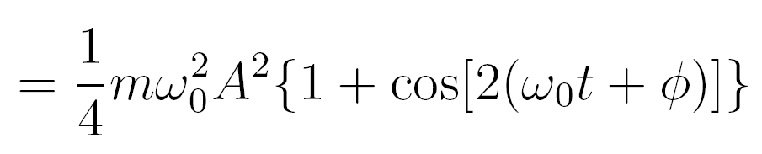
Potential Energy

Slide 30
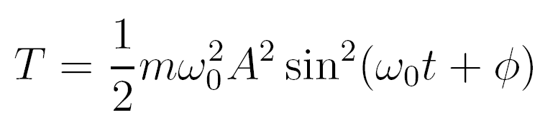
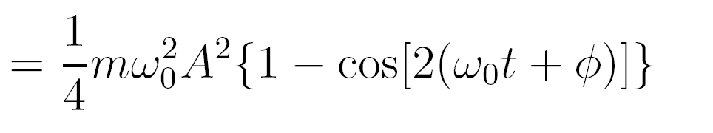
Kinetic Energy

Slide 31


Total Energy

Slide 32
Time Average

Slide 33
Average of oscillations

Slide 34
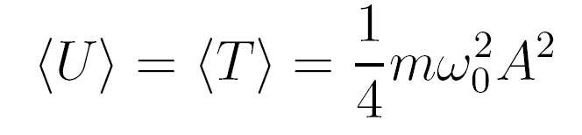
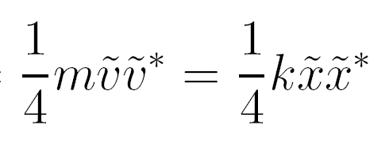
Average Energy

Slide 35
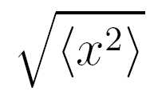
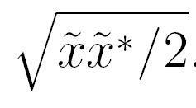
Root Mean Square RMS

Slide 36
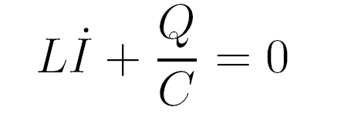



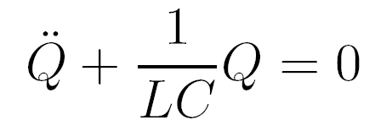

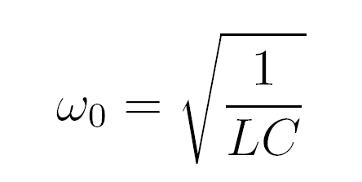
LC Oscillator
Set R=0

Slide 37

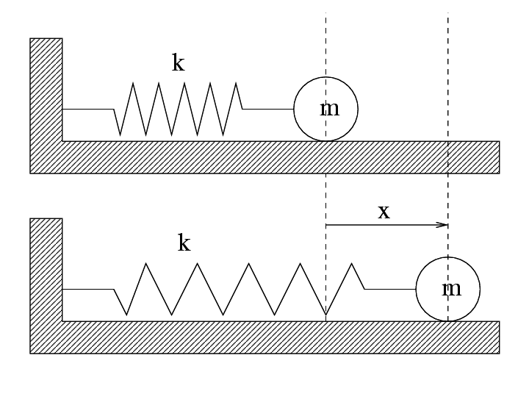
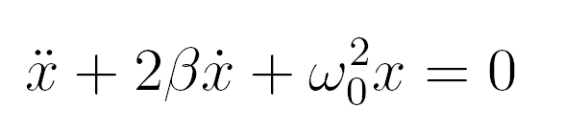
Damped Oscillator
PHYSICS 1
Somnath Bharadwaj and Pratik Khastgir, Department of Physics and Meteorology, IIT Kharagpur, 721 302 India
http://www.cts.iitkgp.ernet.in/~phy1/

Slide 38
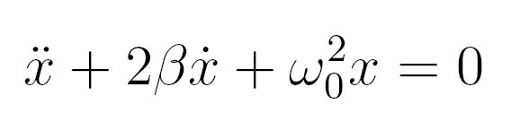
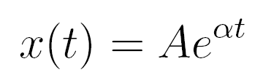
Equation for Damped Osc.
Trial Solution

Slide 39
Roots

Slide 40

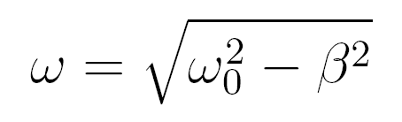
Underdamped

Slide 41
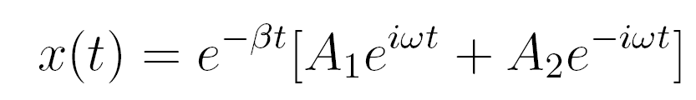
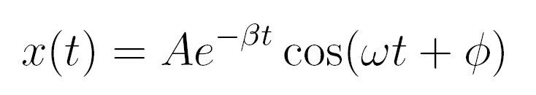
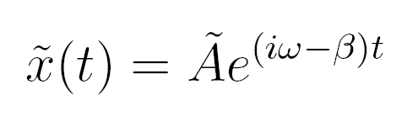
Underdamped Oscillations

Slide 42

An Example

Slide 43
Logarithmic Decrement

Slide 44
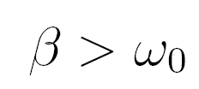
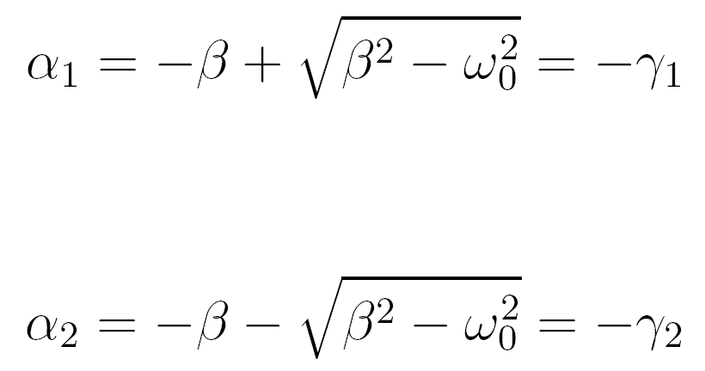
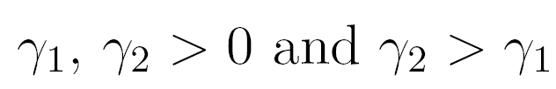
Overdamped

Slide 45
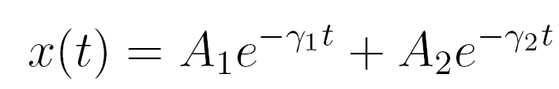
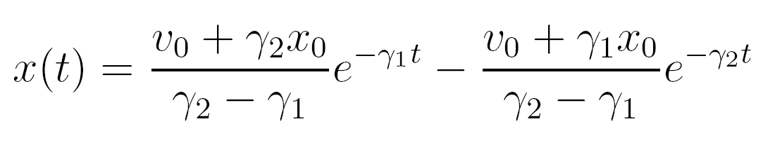
Solutions

Slide 46

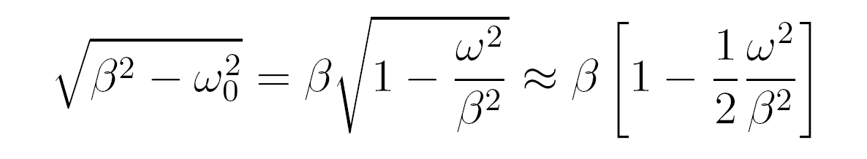
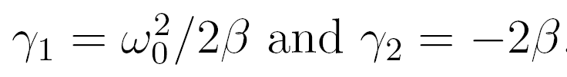
High Damping

Slide 47
Example

Slide 48

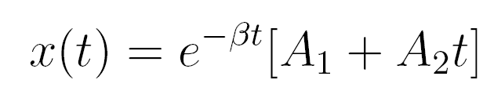
Critical Damping
General Solution

Slide 49

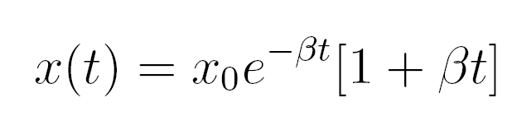
Solutions

Slide 50
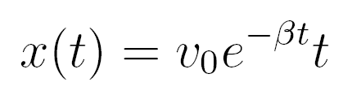

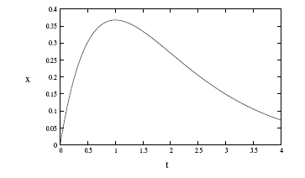
Solutions

Slide 51
Example: Electric circuit

Slide 52
Example: Electric circuit
Underdamped:
Critical damping:
Overdamped:

Slide 53
Problem

